Slide 1
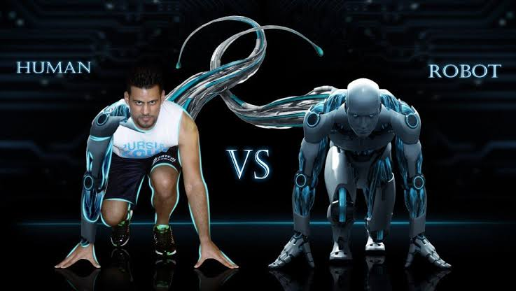

Shri Ram College of Engineering and Management
Department of Computer Science and Engineering
Topic:- Introduction To Artificial Intelligence
Presented By:- Kishan Kumar Rai
Semester:- 4th

Slide 2
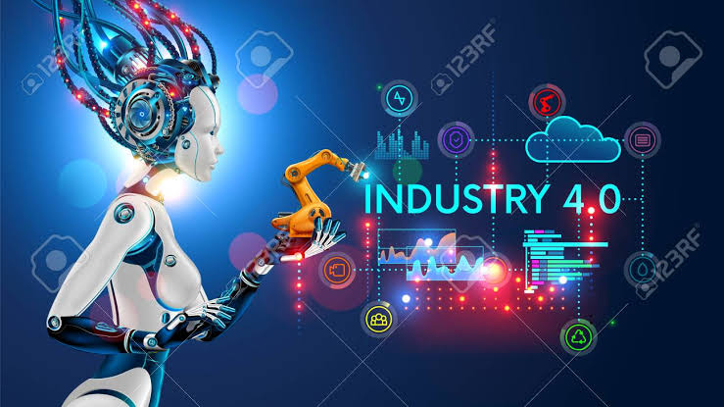
INTRODUCTION TO
ARTIFICIAL INTELLIGENCE

Slide 3
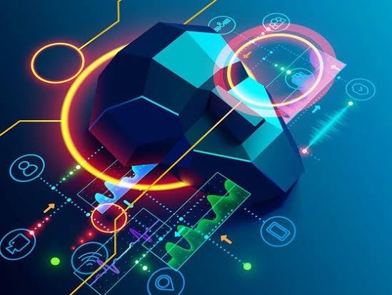
contents:-
Defination of AI
Early History
Types of AI
Current status of AI
Pros and Cons of AI
Future of AI
Conclusion

Slide 4
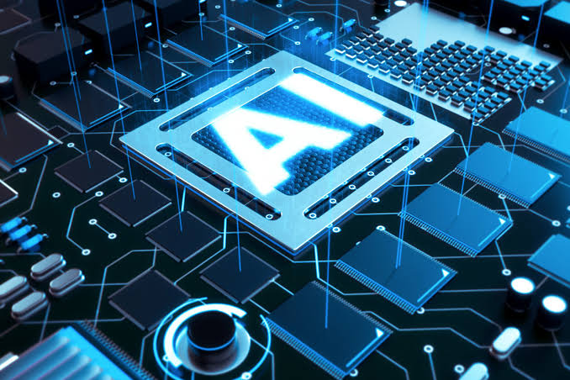
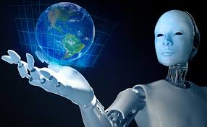
DEFINATION OF AI
The study of computer systems that attempts to model and apply the intelligence of the human mind.
The capability of a machine to imitate intelligent human behavior.
A branch of a computer science dealing with the simulation of intelligent behavior in computer.
Some of the activities computers with AI are designed for include:
Speech recognition
Learning
Planning
Problem solving

Slide 5

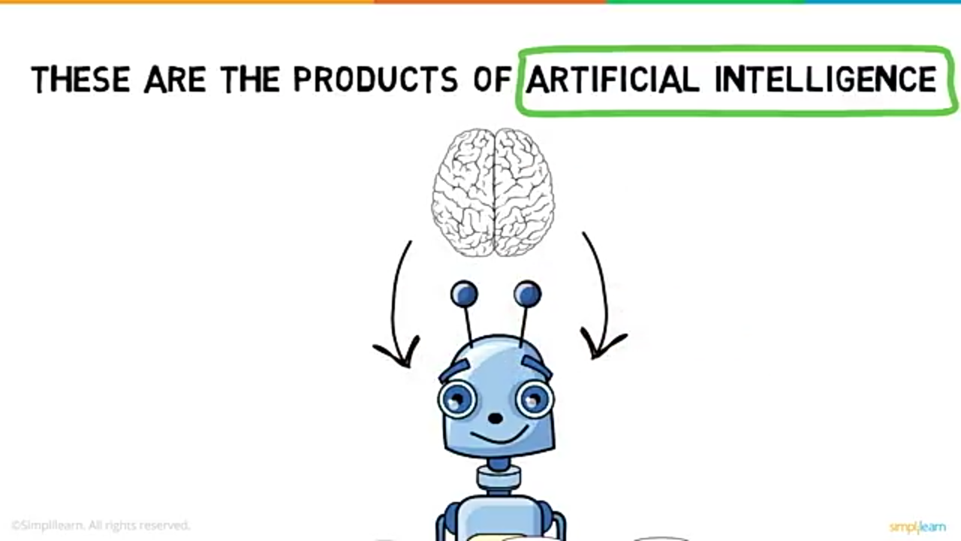
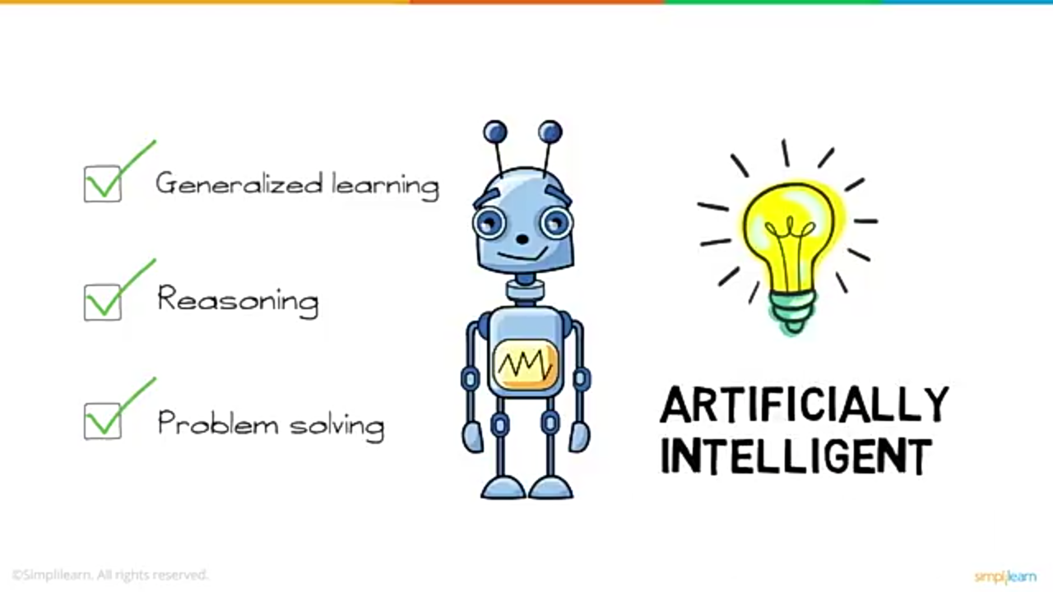

Slide 6
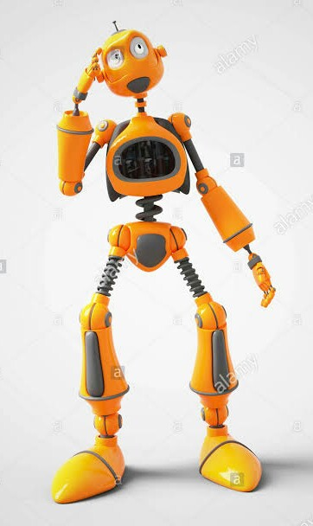
Early History
Early 1940’s
Invention of Modern Computer
Early 1950’s
Computational Statistics
Mid 1950’s
Machine Learning
In 1958
Birth of Artificial Intellegence
Mid 1960’s
Natural Language processing
Late 1960’s
Computer Vision
Late 1970’s
Robotics
1990-2000
Data Mining / Data Science
Early 2010’s
Deep Learning

Slide 7
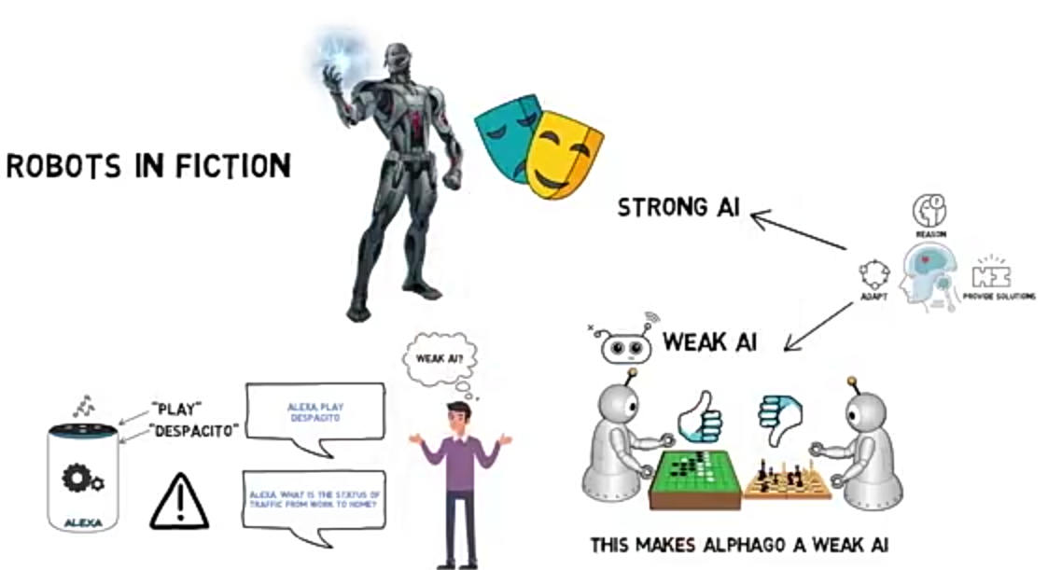
TYPES OF AI
WEAK AI
ALEXA PLAY
DESPACITO
ALEXA! What is the status of traffic near by me?

Slide 8

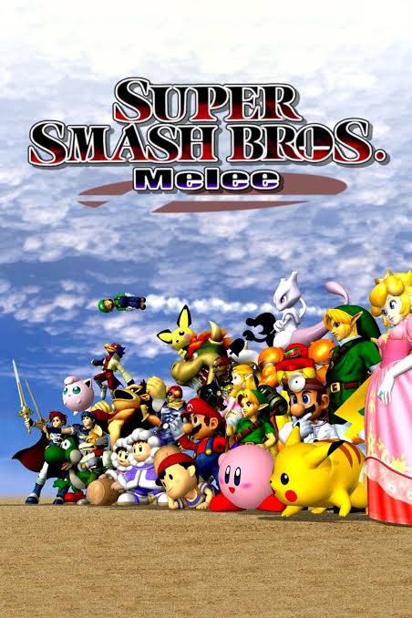
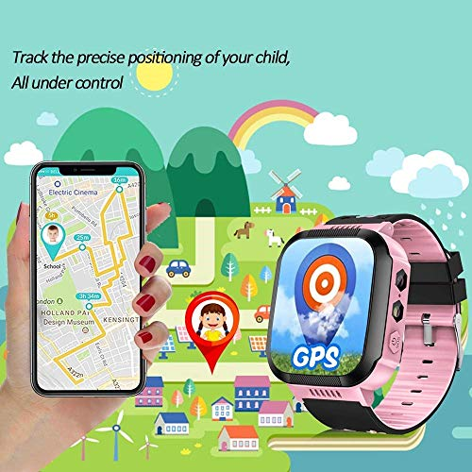
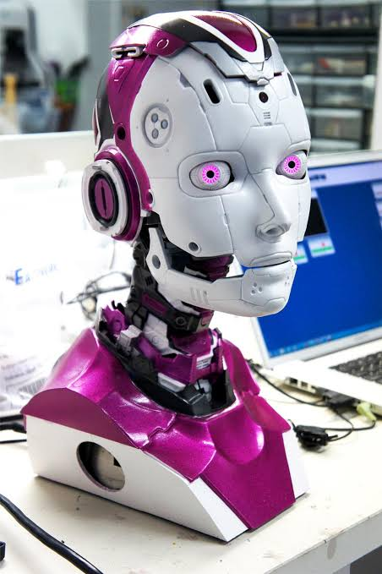
CURRENT STATUS OF A.I.
Mobile phones
(Siri/Cortana)
Video Games
Characters
GPS/Voice
Recognition
Robotics

Slide 9
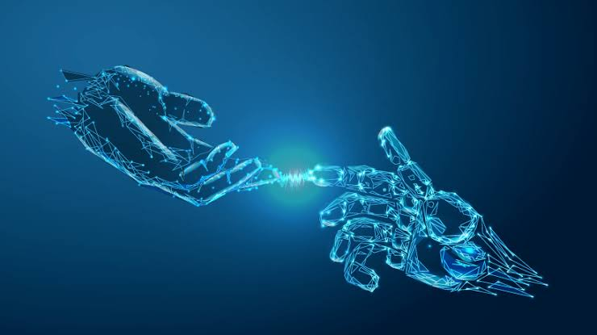
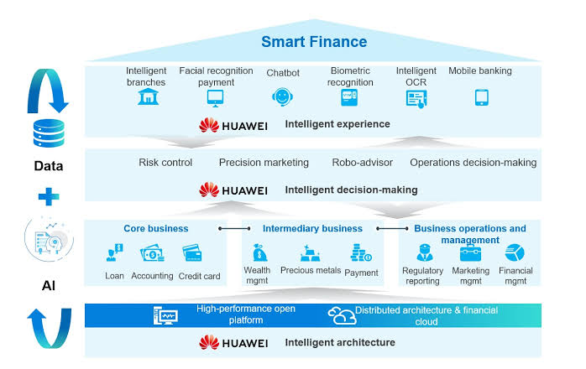
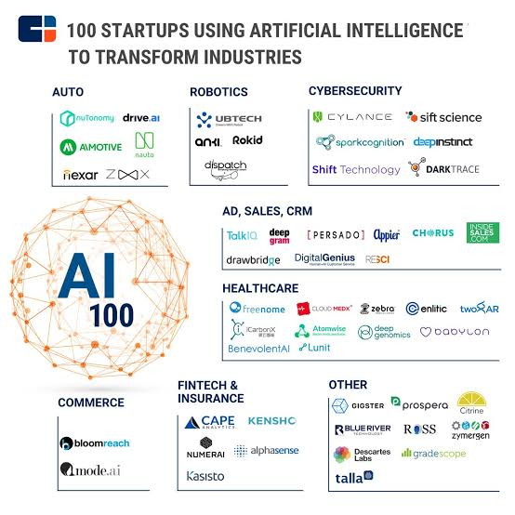
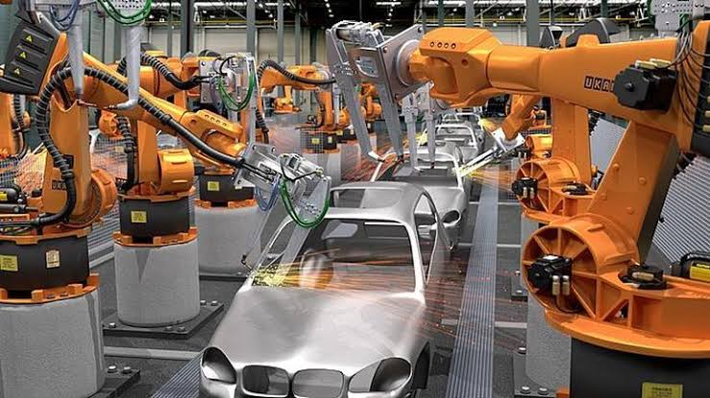
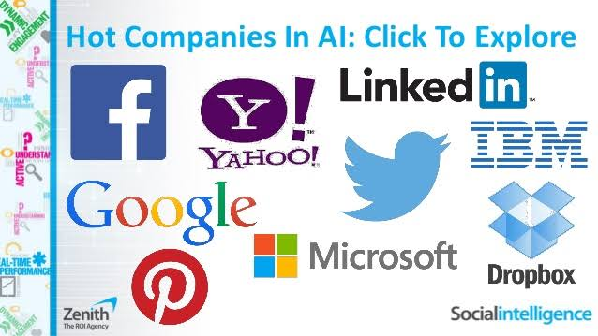
Finance Service
Startups
Manufacturing
Companies

Slide 10
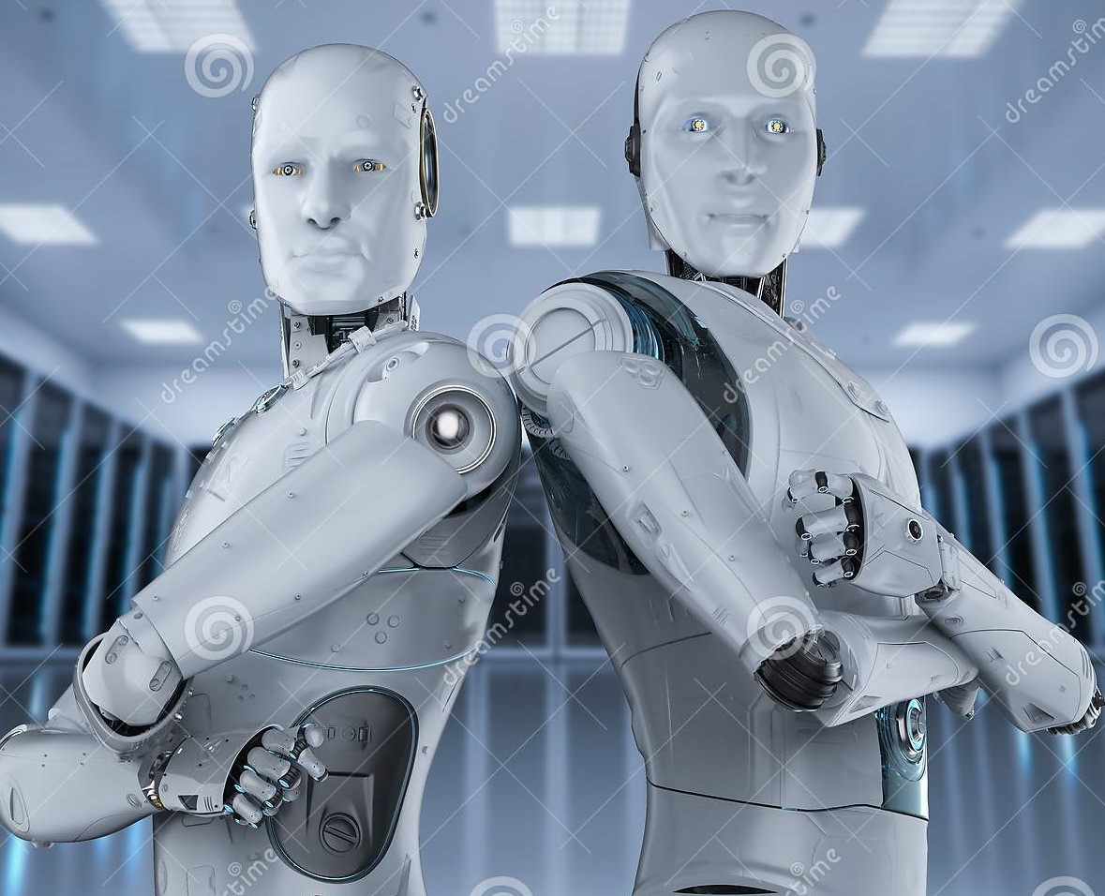
Pros and Cons of AI
PROS:-
Precision and Accuracy.
Space Exploration.
Used for Mining Process.
Fraud Detection.
Robotic Pet and Robotic Radio Surgery.
Diagnosis and Treatment.
CONS:-
Lack of the human touch.
Lack of the creative mind.
Lack of the common sense.
Unemployment.
Abilities of humans may diminish.
Over dependency of humans on machine.

Slide 11
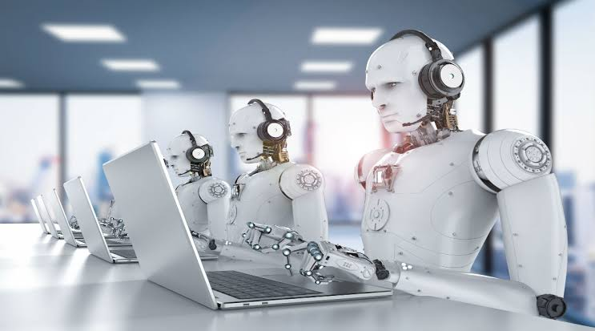
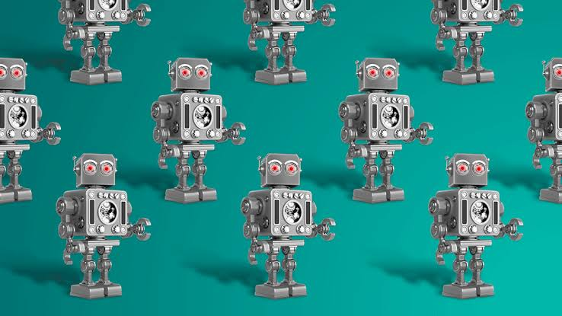
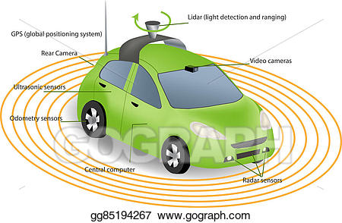
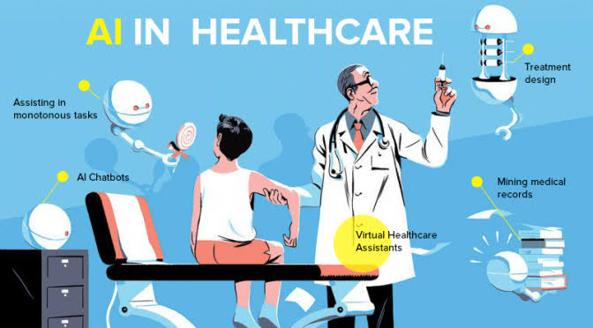

FUTURE OF A.I.
Military bots
Office work
Self driving cars
Healthcare
Smart homes

Slide 12
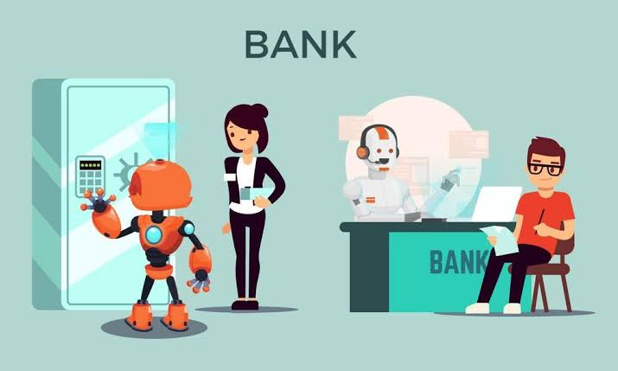
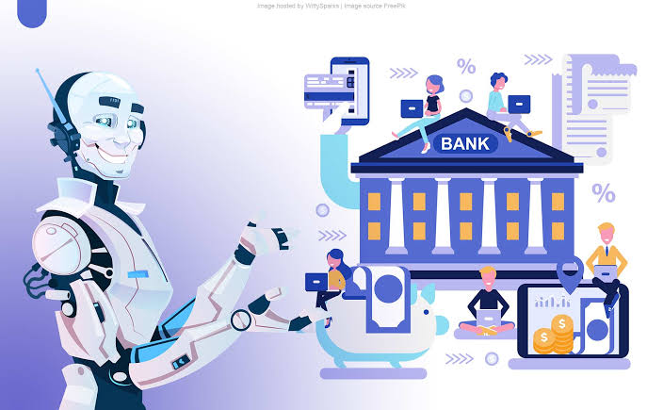
What about BANKS?
The banks will have chat bots.
The banks will have well proved security system using bots armed.
Using AI in banks, it improves the security that work also on facial/voice recognition system.

Slide 13
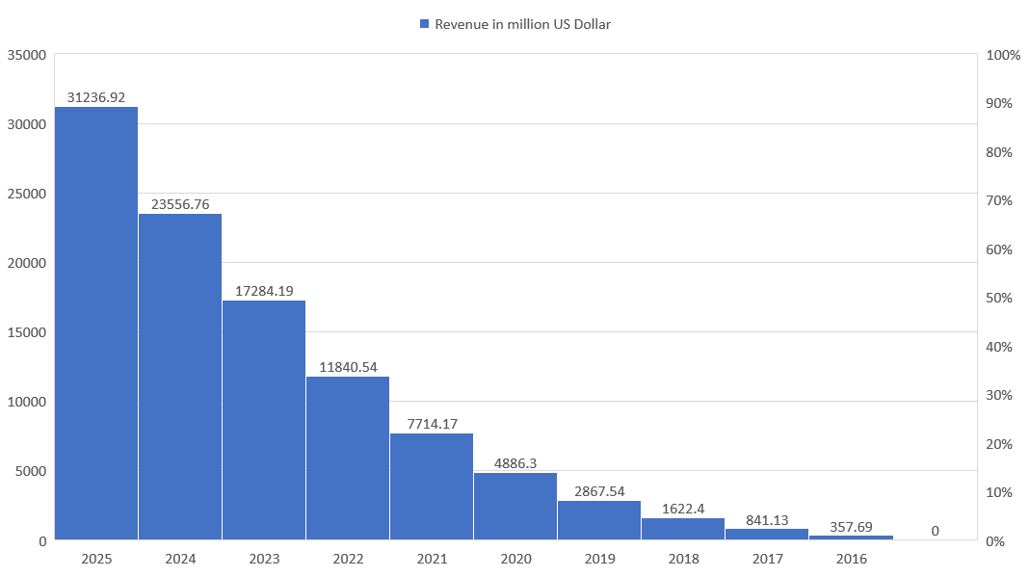
Revenues from the artificial intelligence for enterprise applications market worldwide, from 2016 to 2025 (in million U.S. dollars).

Slide 14
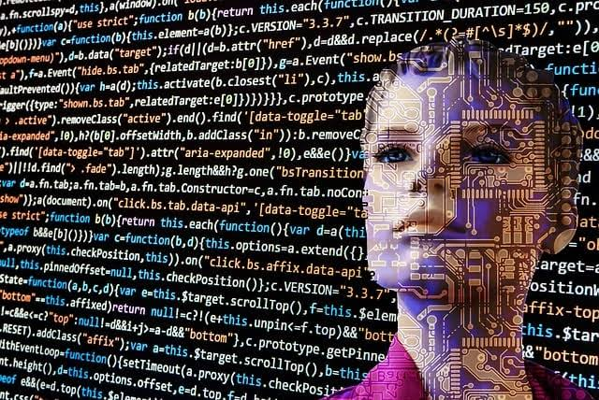
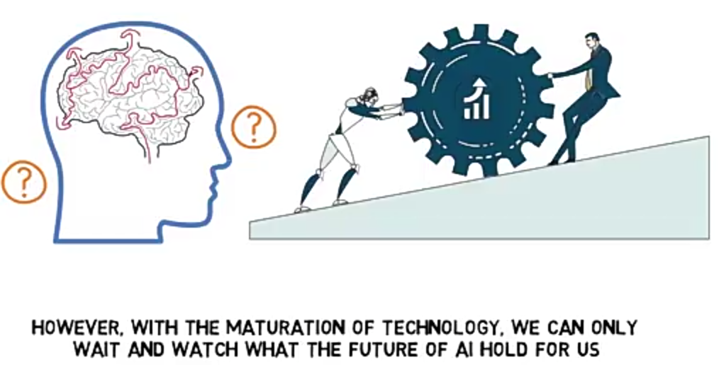
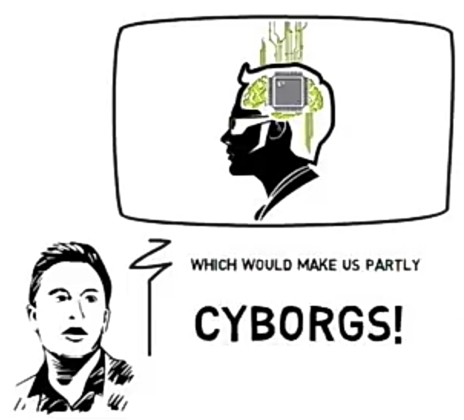
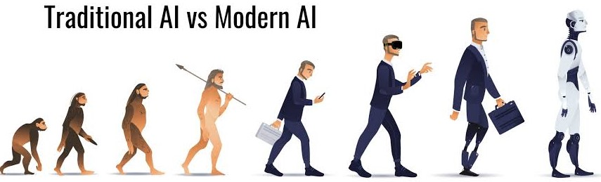
CONCLUSION
Finally we can say that AI is the intelligence of the machine in the branch of computer science that aims to create it.
John McCarthy who coined the term “Science and Engineering are making the Intelligent Machines”.
Games with no AI?
Not possible!
Every game with computer controlled characters/opponents uses some source of AI.

Slide 15
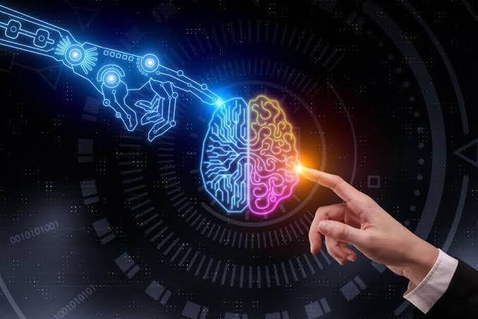
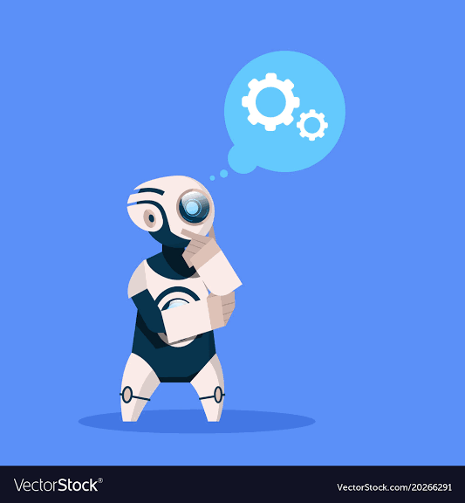
REFERENCES:--
http://en.wilibooks.org/wiki/Computer_Science:Artificial_Intelligence
http://www.howstuffworks.com/artificialintelligence
http://www.google.co.in
http://www.library.thinkquest.org
http://www.slideshare.com:AI

Slide 16
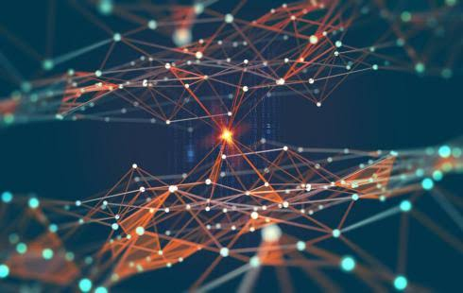
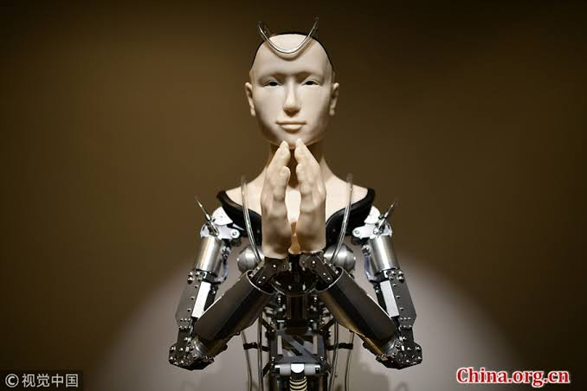
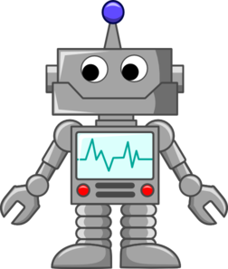
THANK YOU!!

Slide 17
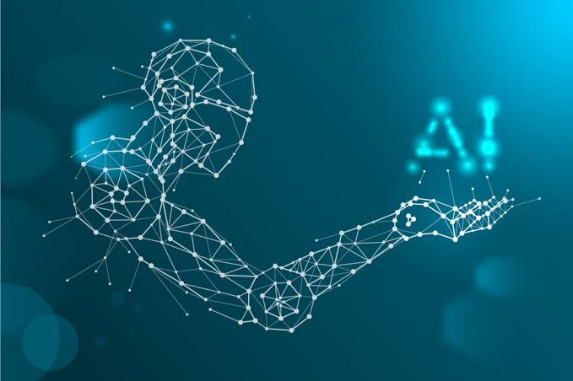
ANY QUERY ??

